Slide 1
INTRODUCTION TO Artificial neural networks
inspired by the way biological neural networks in the human brain process information
Gene Olafsen

Slide 2
ANN – Artificial Neural Networks
Some researchers argue that the biological analogy to 'neurons' should be dropped altogether "lest we restrict our creativity to biologically plausible systems".
ANNs are at the very core of Deep Learning and were first introduced back in 1943 by neurophysiologist Warren McCulloch and mathematician Walter Pitts.

Slide 3
Ann Timeline
1943
Support Vector Machines introduced
Today
Machine Learning is declared, "Software 2.0"
1990's
New network architectures and improved training techniques
Revival of interest
1980's
Dark era as funding leaves ANN research
1960's
ANN introduced

Slide 4
ANN Today
There is now an enormous quantity of data available from which to construct models and train neural networks.
A tremendous increase in computing power aided by the introduction of graphics-based GPU cards. (Big thanks to the gaming industry!)
Small tweaks to established training algorithms have shown to have great impact on model performance.
ANN algorithms that were predicted to remain stuck in local optima, tend to achieve global optima in most cases.

Slide 5
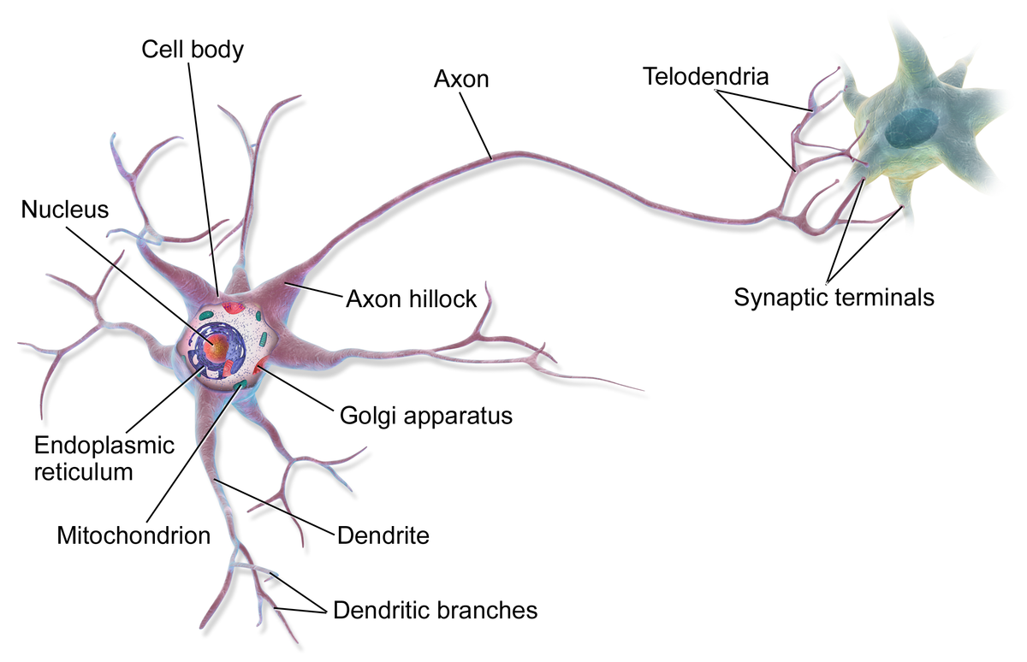
Biological Neurons
Axon length may be up to tens of thousands of times longer than the cell body.
When a neuron receives a sufficient number of signals from other neurons within a few milliseconds, it fires its own signals.
Each neuron is typically connected to thousands of other neurons.

Slide 6
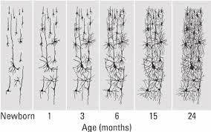
Layers upon layers
The architecture of the human brain indicates that neurons are often organized in consecutive layers.
Layers are a concept that is exploited in Artificial Neural Networks also... especially "Hidden Layers"

Slide 7
Like a switch
The McCulloch/Pitts artificial neuron has one or more binary inputs and one binary output. This artificial neuron simply activates its output when more than a certain number of inputs are active.
Artificial Neurons can even perform various logical computations, as we will see in the next slides.

Slide 8
C = A
The artificial neurons are designated by the green circles "A" and "C"
C
A

Slide 9
C = a and B
C
A
B

Slide 10
C = A or B
C
A
B
Where neurons A and B each "feed" all inputs to C.

Slide 11
c = a AND NOT B
C
NOT
A
B

Slide 12
The perceptron
Invented in 1957 by Frank Rosenblatt, the Perceptron is one of the simpletest ANN architectures based on a linear threshold unit. (LTU)
Inputs and Outputs are a range of numbers instead of a binary (0/1) state.

Slide 13
LTU : Linear Threshold unit
When a target output value is provided for a single neuron with a fixed input- incrementally changing the weights can be used to train the model to produce the expected outcome.
Σ
W
W
W
1
2
3
X
X
X
1
2
3

Slide 14
Ltu and simply classification
A single LTU can be used for simple linear binary classification.
By computing a linear combination of the inputs- the LTU outputs the 'positive' class if the result exceeds a threshold. Otherwise it outputs the negative class.

Slide 15
Multioutput classifier
Outputs
A Perceptron with two inputs and three outputs, can classify instances simultaneously into three different binary classes.
LTU
Output Layer
Σ
Σ
Σ
This is a Bias neuron and always outputs a value of one.
1
These input neurons are a pass-thru.
X1 X2
Inputs

Slide 16
Cells that fire together, wire together
Hebb's rule – the connection weight between two neurons is increased whenever they have the same output.
Perceptron training does NOT reinforce connections that lead to the wrong output.

Slide 17
Perceptron weakness
The decision boundary of each output neuron is linear, so Perceptrons are incapable of learning complex patterns.
Contrary to Logistic Regression classifiers, Perceptrons do not output a class probability- they make predictions based on a hard threshold.

Slide 18
The Scikit-Learn perceptron
Scikit-Learn provides a Perceptron class implementing a single LTU network.
Scikit-Learn's Perceptron class I equivalent to using a Stochastic Gradient Descent classifier.
The Perceptron class is the same as using the SGDClassifier with the following hyperparameter settings:
loss = "perceptron"
learning_rate = "constant"
eta0=1 (this is the learning rate)
Penalty = None (no regularization)

Slide 19
In 1969 Marvin Minsky and Seymour Papert highlighted a number of serious Perceptron weaknesses- indicating they are incapable of solving some trivial problems.
These limitations are true of any other linear classification model- however researchers had expected more from Perceptrons.

Slide 20
MLP: multi-layer perceptrons
Some of the limitations of Perceptrons can be eliminate by stacking multiple Perceptrons.
In particular, MLP's can solve the XOR problem (described earlier).

Slide 21
Hidden layers
Outputs
This model accepts two inputs and classifies to three outputs.
Σ
Σ
Σ
1
Hidden
Layer
Σ
Σ
Σ
Σ
1
X1 X2
Inputs

Slide 22
DNN: Deep neural network
An ANN (Artificial Neural Network) having two or more hidden layers, is known as a deep neural network.
Output Layer
Hidden Layer
Hidden Layer
Hidden Layer...
Input Layer

Slide 23
Backpropagation breakthrough
Multi-Layer Perceptron training confounded researchers for many years without much success.
In 1986, D.E. Rumelhart published a groundbreaking article introducing the backpropagation training model algorithm.
Essentially we know this today as "Gradient Descent utilizing reverse-mode autodiff".

Slide 24
Backpropagation explained
"For each training instance the backpropagation algorithm makes a prediction (forward pass), measures the error, then goes through each layer in reverse to measure the error contribution from each connection (reverse pass), and finally slightly tweaks the connection weights to reduce the error (Gradient Descent)"*
* Hands-On Machine Learning with Scikit-Learn & TensorFlow, Aurelien Geron, O'Reilly Publishing

Slide 25
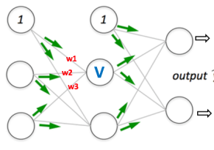
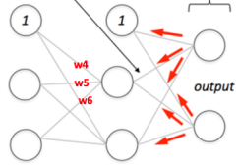
Longer explanation
The forward and reverse passes of backpropagation simply perform reverse-mode autodiff.
Forward Pass Reverse Pass

Slide 26
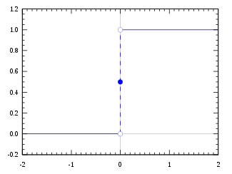
For backpropagation to work...
The MLP architecture utilized a step function as the activation function.
The step function only contains flat segments- there is NO gradient to work with. (Gradient Descent cannot move on a flat surface).
The replacement with a logistic function (Sigmoid Curve or equivalent) which has a well-defined nonzero derivative everywhere- allowing the Gradient Descent to make some progress at every step.

Slide 27
Activation functions
There is an entire slide deck dedicated to activation functions:
Logistic (Sigmoid) Function
Hyperbolic Tangent
ReLU

Slide 28
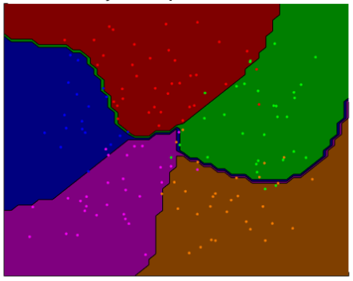
MLP Classification
MLP is often used for classification, with each output corresponding to a different binary class.

Slide 29
Mlp classification
Softmax
Output
Layer
Each neuron of the output layer has it's individual activation function replaced with a shared softmax activation function.
Σ
Σ
Σ
1
Hidden
Layer
Σ
Σ
Σ
Σ
1
X1 X2
Inputs

Slide 30
Single hidden layer
It has been shown that an MLP with just one hidden layer can model even the most complex functions- provided it has enough neurons.

Slide 31

Non-biological activation
Biological neurons seem to implement a roughly sigmoid (S-shaped) activation function. A such, AI/ML researchers tended to stick with sigmoid functions for a long time. However, it turns out that the ReLU activation function typically works better for Artificial Neural Networks.
This is one such example where the biological analogy turned out to be misleading.

Slide 32
Simple MLP with Tensorflow
The DNNClassifier class is the easiest way to train a deep neural network with the number of hidden layers you define and a softmax output layer to estimate class probablilities.

Slide 33
DNNClassifier code
2 Hidden Layers
import tensorflow as tf
config = tf.contrib.learn.RunConfig(tf_random_seed=42) # not shown in the config
feature_cols = tf.contrib.learn.infer_real_valued_columns_from_input(X_train)
dnn_clf = tf.contrib.learn.DNNClassifier(hidden_units=[300,100], n_classes=10,
feature_columns=feature_cols,
config=config)
dnn_clf = tf.contrib.learn.SKCompat(dnn_clf) # if TensorFlow >= 1.1
dnn_clf.fit(X_train, y_train, batch_size=50, steps=40000)
Softmax output layer with 10 neurons

Slide 34
DNNClassifier
The DNNClassifier creates all of the specified neuron levels.
The activation function can be defined by the activation_fn hyperparameter and defaults to the ReLU activation function.
The output layer relies on the softmax function.
The cost function is cross entropy.

Slide 35
Contrib namespace
The tensorflow.contrib package namespace is a place for experimental code that has not been locked down to part of the core TensorFlow API.
The DNNClassifier class is part of the tensorflow.contrib package, as such, this class's definition is subject to change in the future without notice.
(In practice though... many changes simply result in deprecation or other warnings as the TensorFlow codebase evolves.)

Slide 36
So many options...
Neural network topology flexibility is practically limitless.
How to interconnect neurons.
How many layers to define.
How many neurons per layer.
Which activation function to use (in each layer).
How to initialize weights.

Slide 37
Fine-tuning neural network hyperparameters
Since training a neural network on a large dataset takes a lot of time, it is only possible to explore a small part of the hyperparameter space given these constraints.
It is helpful to have an idea of the reasonable hyperparmeter values to help define the search space.

Slide 38
Hidden layers
Deep networks (those with more than two hidden layers) have much higher 'parameter efficiency' then those models with less layers.
Lower layers model low-level structures.
Intermediate layers combine the low-level structures.
Higher layers combine the intermediate layer structures, etc.

Slide 39
Hidden layers = good stuff
The hierarchical architecture helps Deep Neural networks:
Converge on a solution faster
Generalize new datasets

Slide 40
Re-using weights and biases
If you already have a network which recognizes cars and you want to train a new network that specifically identifies convertibles, you can jumpstart the training of this model by reusing the lower layers of the first network.
Instead of randomly initializing the weights and biases of the first few layers of the new neural network, the weights and biases can be initialized to the value of the weights and biases of the lower layers of the first network.

Slide 41

Number of neurons per hidden layer
A common approach to identifying the number of neurons in each hidden layer is to select a size which results in a funnel.
In a MNIST example, the Input layer contains 768 neurons, the output has 10 neurons... the hidden layers may contain 300 and 150 respectively.

Slide 42
TiP: Neurons and layers
In general, better results may be achieved by increasing the number of layers in a model than the number of neurons per layer.

